Slide 1

Final Project
Big Data Predictions of Stock Prices in R
Dietmar Aumann
CSCI E185 Big Data Analytics
Harvard Extension School
@Dietmar Aumann

Slide 2
READ ME
These slides are for illustration purposes for the
Big Data Predictions project
-
Please watch my YouTube presentation for further explanations or read my full report in which the images used here are explained in greater detail
@Dietmar Aumann

Slide 3
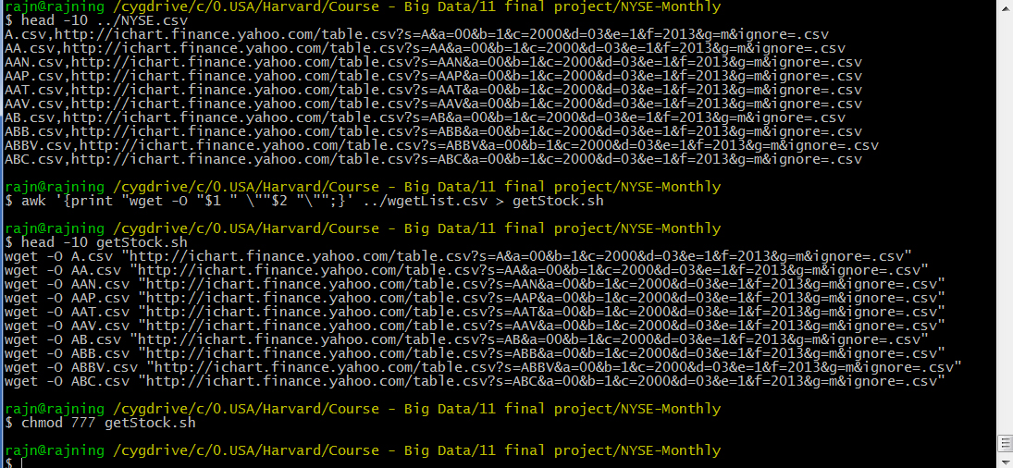
1. Getting the data
A script is used (attached in my submission as getStock.sh) to download all available stocks as monthly close prices from http://finance.yahoo.com
@Dietmar Aumann

Slide 4
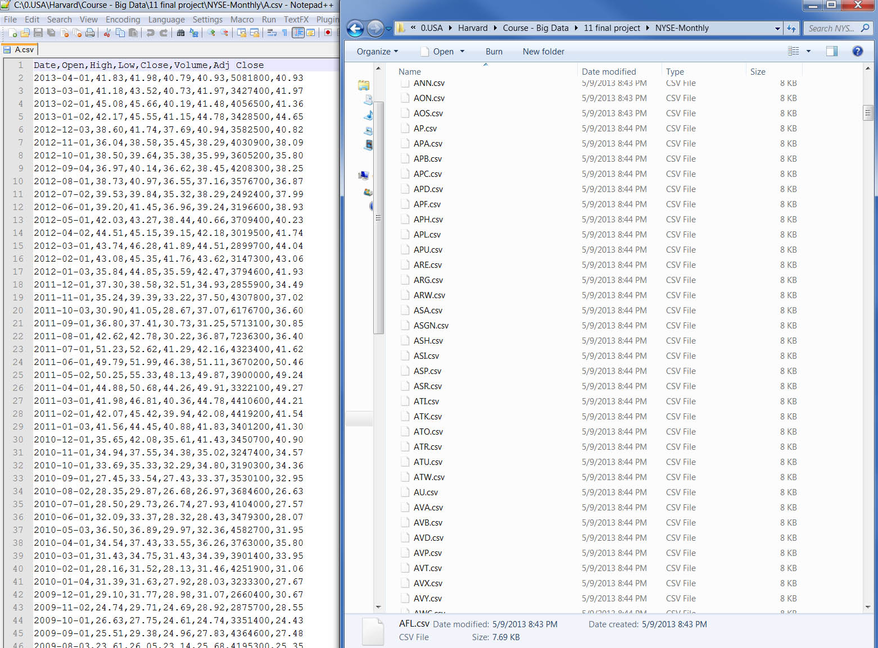
1. Getting the data
This is how the resulting CSV files should look like.
@Dietmar Aumann

Slide 5
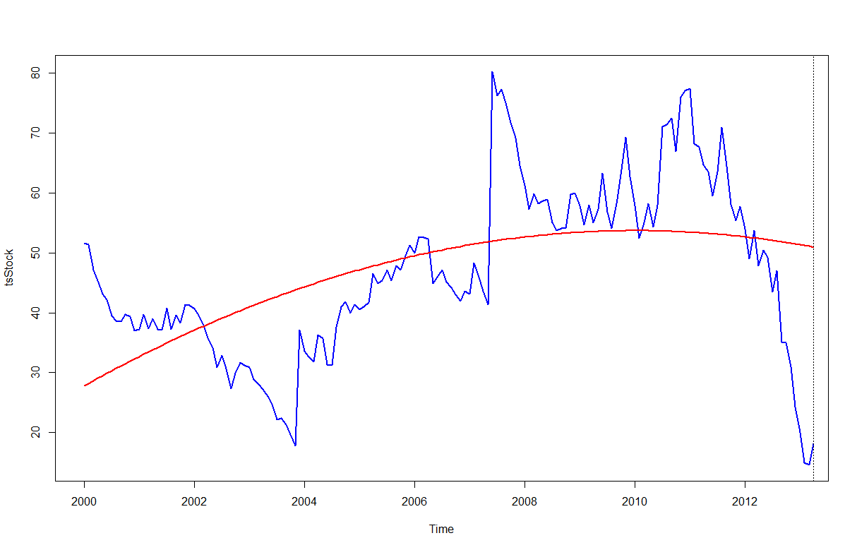
2. Trying out different approaches
Please open the attached Report to understand the following scripts and according plots, here are the script + plot combinations:
tl = seq(2000,2013,length=length(tsStock))
tl2 = tl^3
polyStock = lm(tsStock ~ tl + tl2)
tsStocktrend1=ts(polyStock$fit,start=c(2000, 1),frequency=12)
@Dietmar Aumann

Slide 6
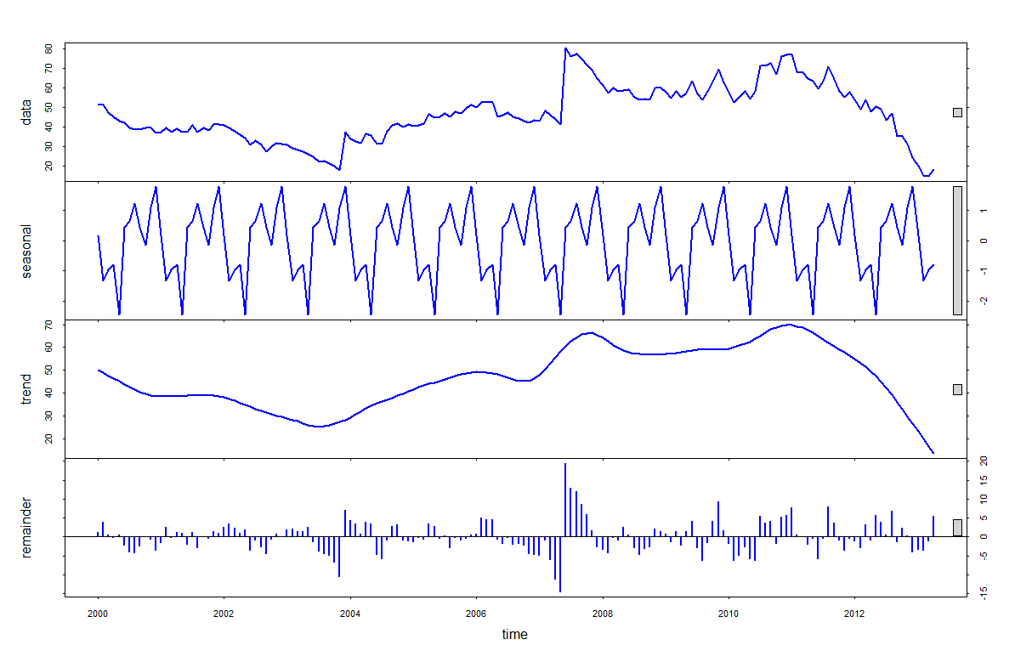
2. Trying out different approaches
stlStock = stl(train,s.window="periodic")
tsStocktrend2 = stlStock$time.series[,2]
@Dietmar Aumann

Slide 7
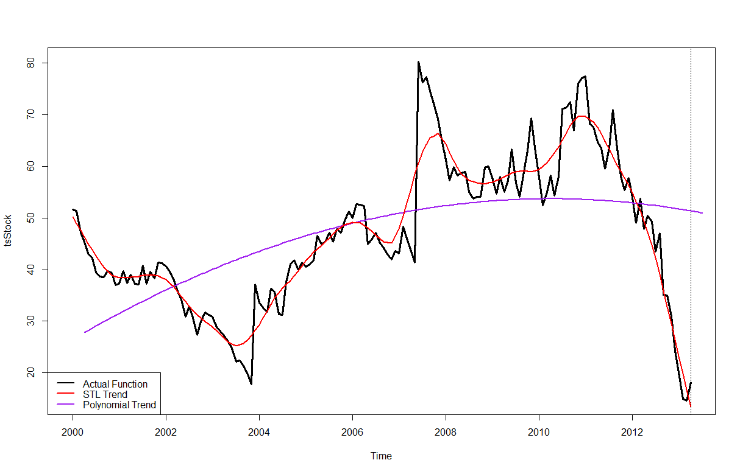
2. Trying out different approaches
Overview of the three base functions on which the predictions will be based on:
@Dietmar Aumann

Slide 8
2. Trying out different approaches
The following predictions for the three base plots (Polynomial, STL, actual graph) are based on the following underlying Code:
Holt Winter Filtering
HWStock1_ng = HoltWinters(tsStocktrend1,gamma=FALSE)
HWStock1 = HoltWinters(tsStocktrend1)
Neural Networks
NETfit1 <- nnetar(tsStocktrend1)
ARIMA model
autofit1 = auto.arima(tsStocktrend1)
fit12 <- arima(tsStocktrend1, order=c(1,0,0),list(order=c(2,1,0), period=12))
Linear Model
fitl1 <- tslm(tsStocktrend1 ~ trend + season, lambda=0)
STL Model
stlStock1 = stl(tsStocktrend1,s.window="periodic")
@Dietmar Aumann

Slide 9
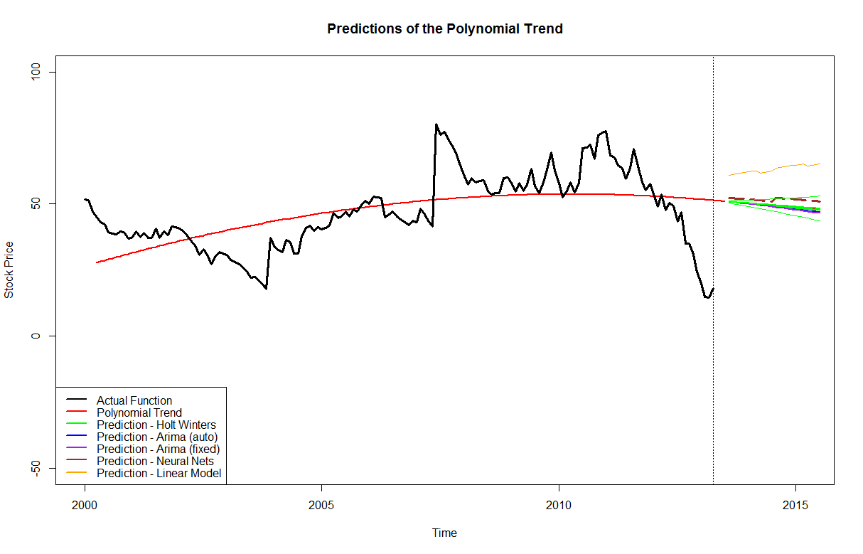
2. Trying out different approaches
@Dietmar Aumann

Slide 10
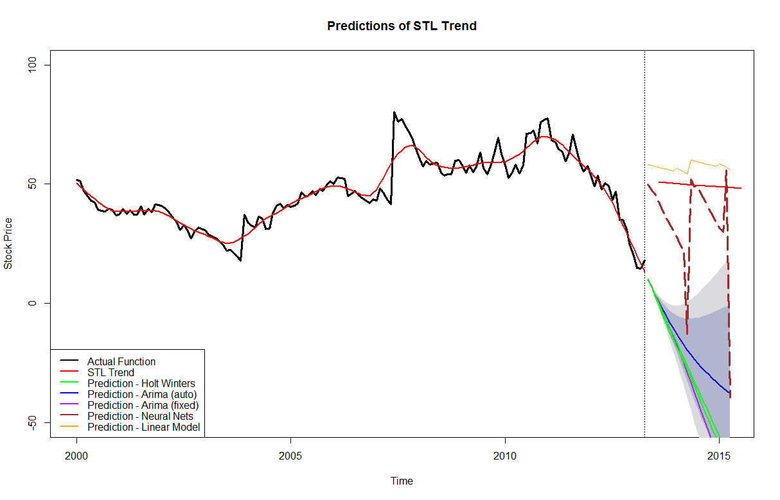
2. Trying out different approaches
@Dietmar Aumann

Slide 11
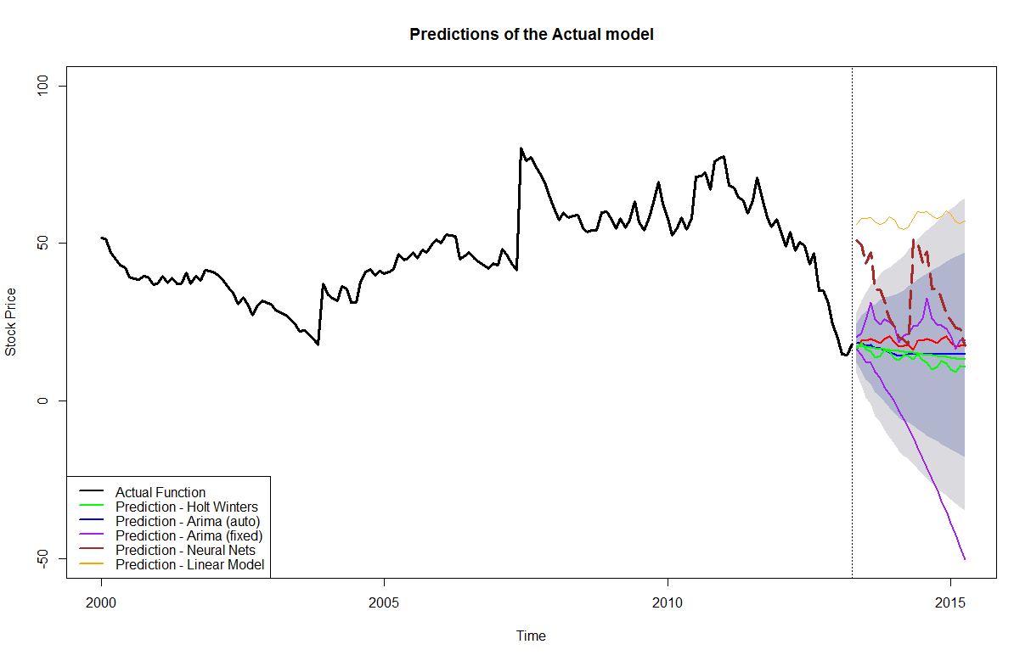
2. Trying out different approaches
@Dietmar Aumann

Slide 12
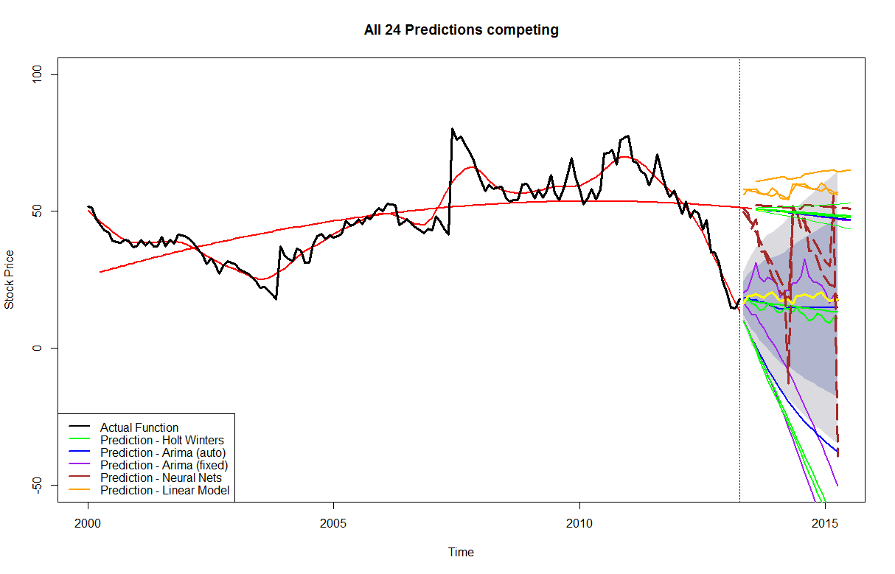
3. Evaluating the techniques
This is an overview of all 24 Predictions, which compete in the evaluation
@Dietmar Aumann

Slide 13
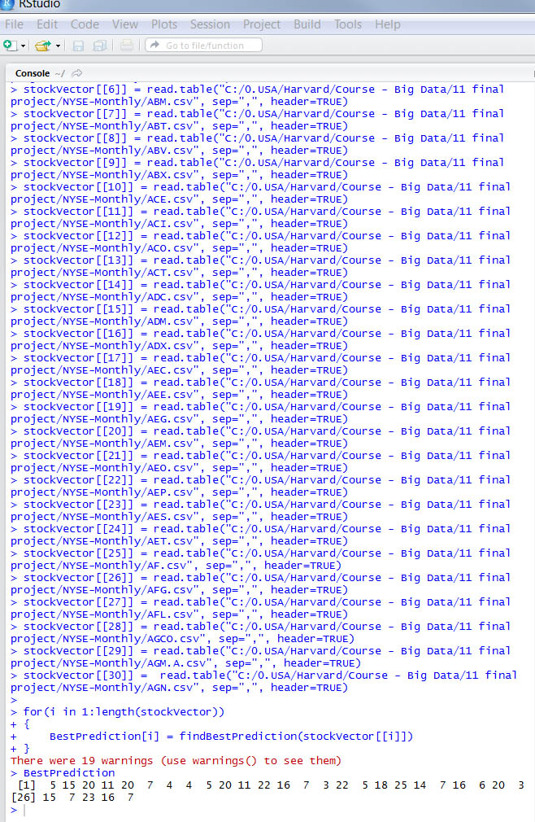
3. Evaluating the techniques
Using the attached script runTestEvaluation.r
which calls attached function
findBestPrediction.r, we compute the 24
predictions for 30 different stock graphs,
which we divided into test and train parts,
and compute the Absolute Mean Error of the
predicted values compared to the actual
values.
The result can be seen on the right.
The winning techniques were:
1. ARIMA model with auto parameters (5 times the best)
2. Linear model with trend, season components (4 times the best)
3. Holt-Winters Filtering (3 times the best)
Holt-Winters Filtering with exponential smoothing (3 times the best)
@Dietmar Aumann

Slide 14
4. Discussing the results and Outlook
Of course an evaluation for only 30 stocks can be improved by using 300
or more – try it!
Also try using different parameters for the prediction functions to get different results!
When you have selected your winning technique, try to find the top 10 stocks, which are most promising for the next 2 years.
Find a suitable criterion for that and let me know which stocks you found and which predicting method you used ☺
You can contact me via dietmar.aumann@gmail.com
@Dietmar Aumann

